Slide 1
Welcome!
DESIGNED BY MICHAEL PANAIT FOR HACK CLUB ARCADE
REPLACE (school’s) Hack Club with your Hack Club’s Name!
Feel free to modify anything in this presentation file.
(Your School) Hack Club - OnBoard Meeting
Workshop 1 - Hacker Card - Session 1: Placing Components

Slide 2

Welcome to OnBoard!
This will be the first Hack Club workshop of this semester! After this, you should receive $100 to put your card into production and build another project for the Spring Ship!
This will be split into 4 sessions - 25 minutes each
Intro to EasyEDA and Schematic Design
EasyEDA PCB Design
EasyEDA PCB Design: Adding a spin!
Submitting your project to JLCPCB and OnBoard

Slide 3
What will we be learning?
Basic Electrical Engineering
PCB Routing and Design
Schematics
Forks, Pushing/Pulling, and Requests in GitHub

Slide 4
Step 1: Make a EasyEDA account
Go to easyeda.com and click Design Online
Launch EasyEDA STD, do not select EasyEDA PRO,
On the top right, click “Register”
Make an account. Please DO NOT USE A SCHOOL EMAIL.
Manually or through Google is fine.

Slide 5
Step 2: Create an EasyEDA Project
Under “Quick Start”, select “New Project”
Set your project title to NFC Hacker Card
Hit “Save”
Now, we’ll show you the rest!

Slide 6
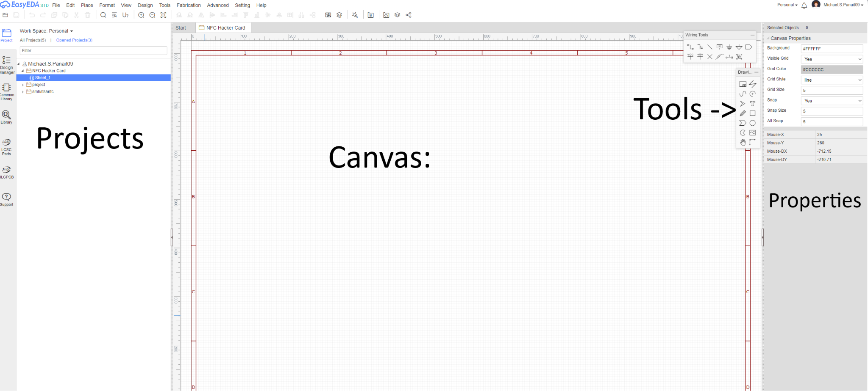
Welcome to the schematic editor!

Slide 7
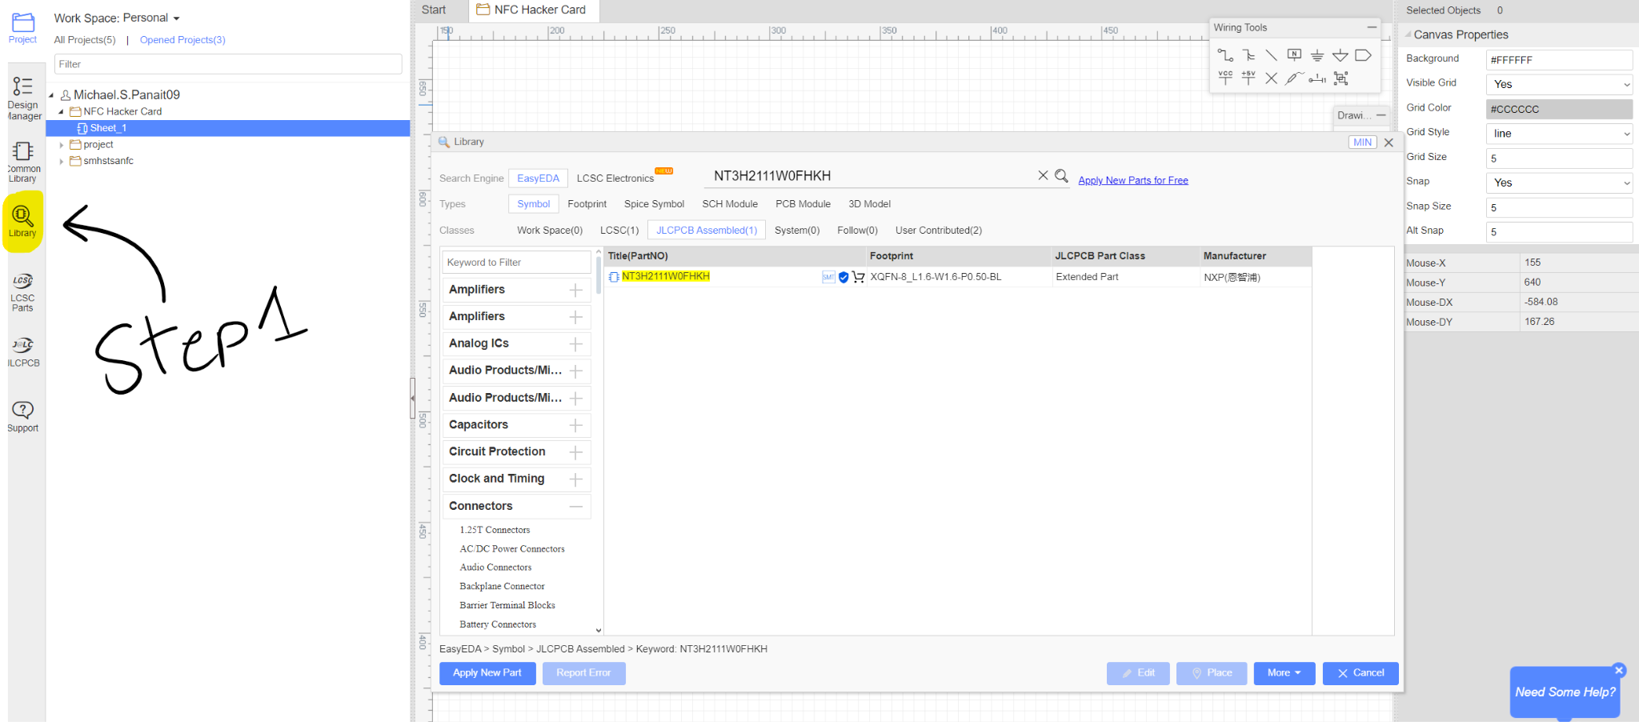
Step 1: Opening Library
This is where you can find every component for every project! Click on the Library
button on the left side bar.

Slide 8
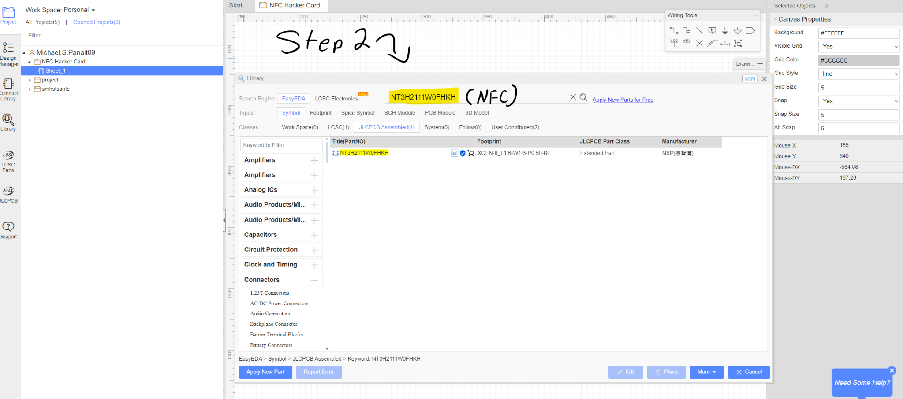
Step 2: Searching LCSC for the NFC Chip
For this, we’ll be using the NXP NTAG I²C 2K chip (NT3H2111W0FHKH). This holds the card’s data, talks to your phone, and powers the electronics on the board. Type it in the search box!

Slide 9
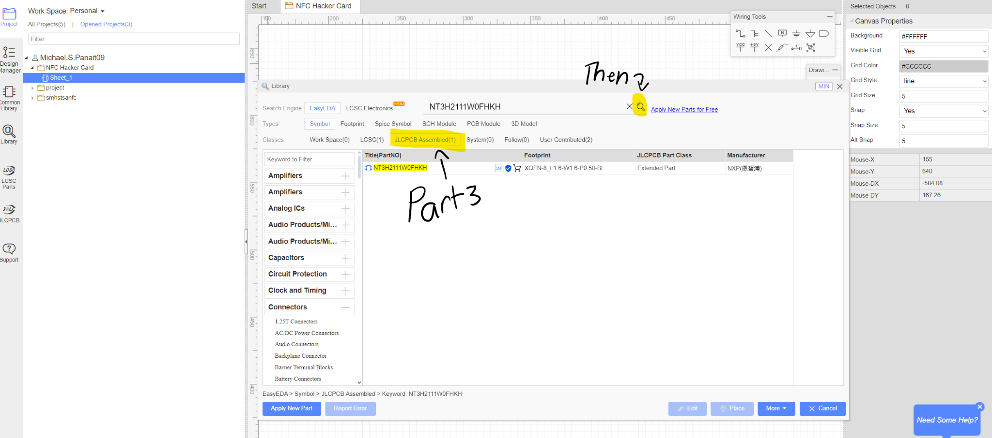
Step 3: Searching LCSC for the NFC Chip
We need to make sure JLCPCB can find the parts for this project, select JLCPCB Assembled on the search options, then hit search.

Slide 10
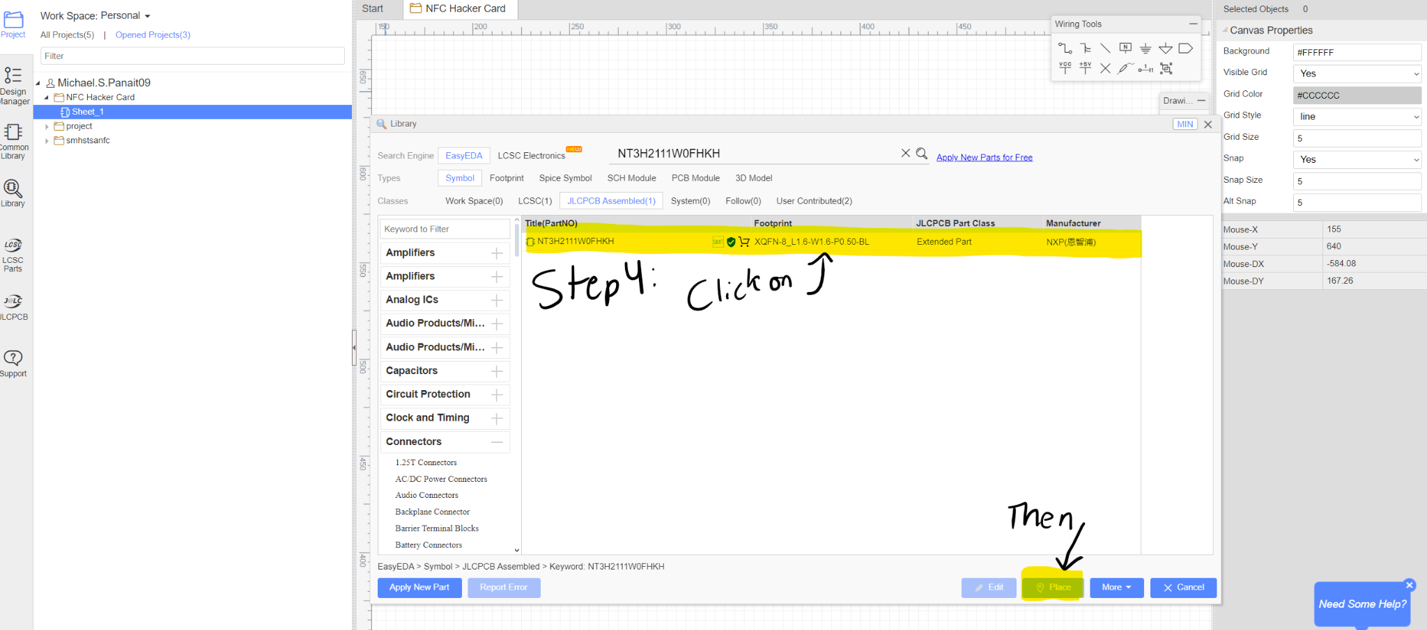
Step 4: Selecting the NFC Chip
There should only be one option, click on the result and select Place to bring the chip into the canvas.

Slide 11
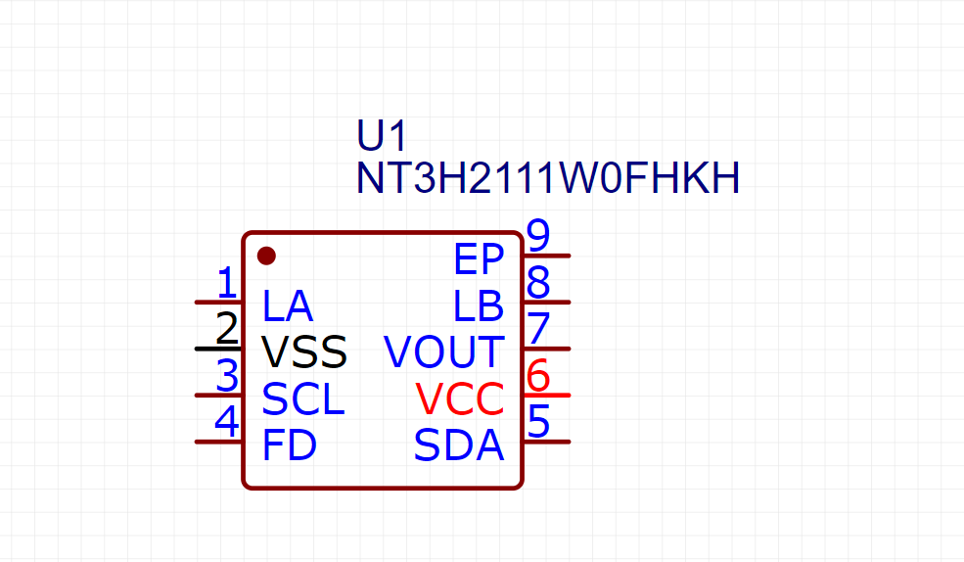
Step 5: Placing the NFC Chip
Click anywhere on the canvas to place the NFC Chip on the canvas. Then, hit ESC to stop placing chips.

Slide 12
Step 6: Adding the other parts:
Repeat steps 1-5 for each of these parts. Here’s what each part means:
17-21SUYC/TR8 - Orange LED - Indicates NFC Status
0603WAF470JT5E - Resistor - Limits the voltage reaching the LED
CL10B224KA8NNC - Capacitor - Acts as a “battery” for the NFC Chip

Slide 13
Thanks for coming!
See you at the next meeting on ________ (08/XX/2X)

